Slide 1
TELECOM CHURN PREDICTION

Slide 2
Problem Statement
Customer churn is a big problem for telecommunication companies. Indeed, their annual churn rates are usually higher than 10%. For that reason, they develop strategies to keep as many clients as possible. This is a classification project since the variable to be predicted is binary (churn or loyal customer). The goal here is to model churn probability, conditioned on the customer features. telecommunications

Slide 3
Contents
Read the data
EDA
Correlation Analysis
Distribution Plot
Outliers Analysis
Feature Engineering
Visualizations
(Heatmaps, Bargraphs, Pie chart, Boxplot, ROC Curve)

Slide 4
Model Building
Split the given data into Training and Testing data
Regression Models Used:
Random forest
Gradient boosting
SVM
K-Nearest neighbors (KNN)
Logistic Regression

Slide 5
Deployment:
Deployment through Streamlit
(Considered SVM model for Deployment with 99% accuracy)

Slide 6
Libraries Used:
Pandas
Numpy
Sklearn
Matplotlib
Seaborn
Math
Yellowbrick
Streamlit (deployment)

Slide 7
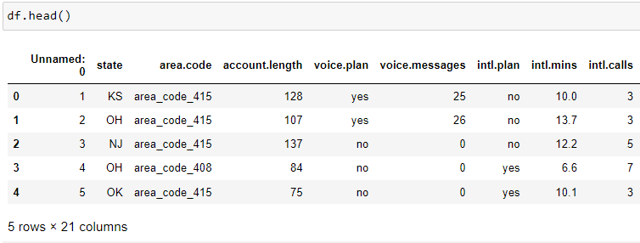
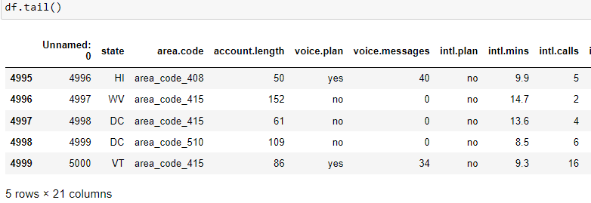
Reading The Dataset

Slide 8
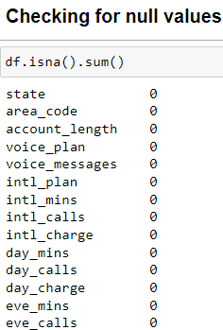
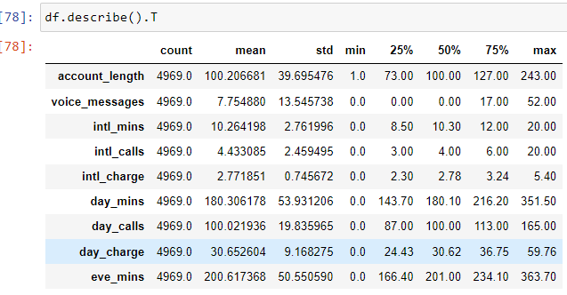
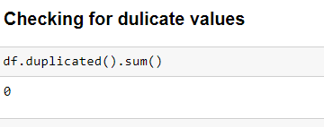
EDA

Slide 9
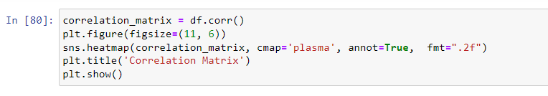
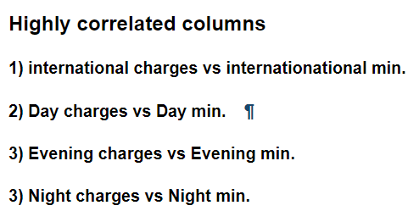
Correlation Analysis

Slide 10
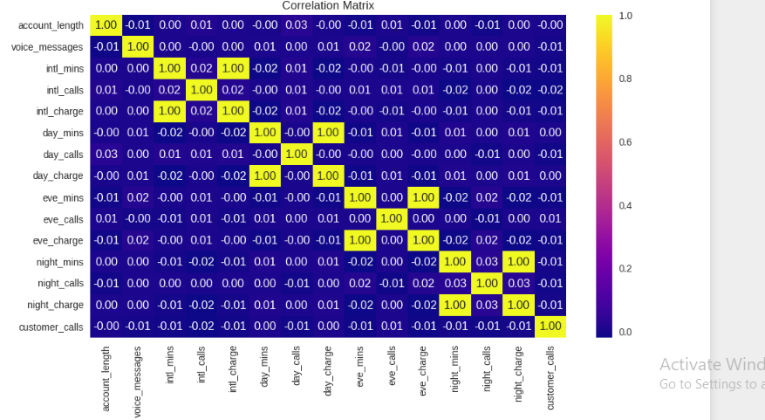
Heatmap for Correlation Analysis

Slide 11
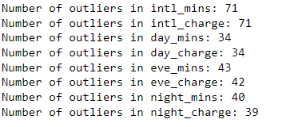
Outlier Analysis
In Outlier Analysis we found some outliers in below columns
We fixed them using IQR(Inter Quartail Range)

Slide 12
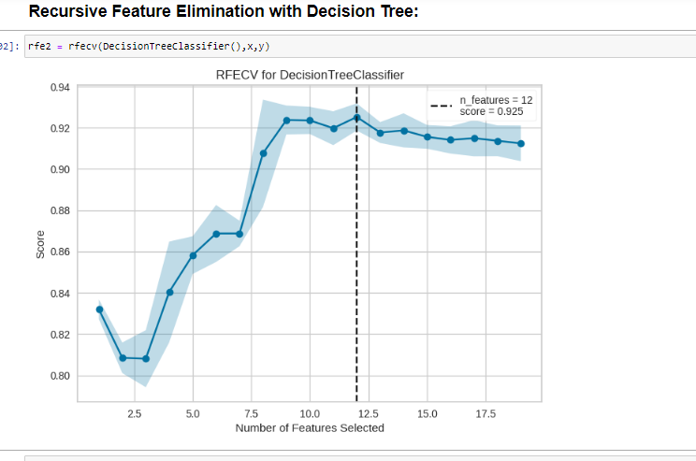
Feature Engineering
We have done Recursive Feature Elimination using Decission Tree to eliminate least ranked columns and Balanced the dataset

Slide 13
Model Building
We have used True Positive and True Negative Rates method on the following regressors ,
Logistic Regression
Random Forest
Gradient Boosting
SVM
KNN
Naïve Bayes

Slide 14
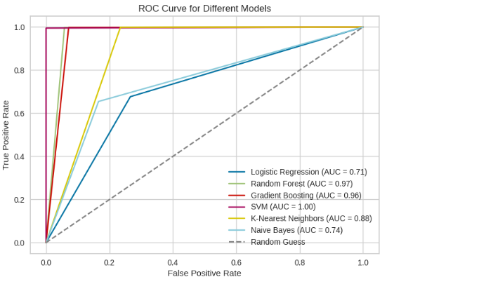
ROC Curve for Different Models

Slide 15
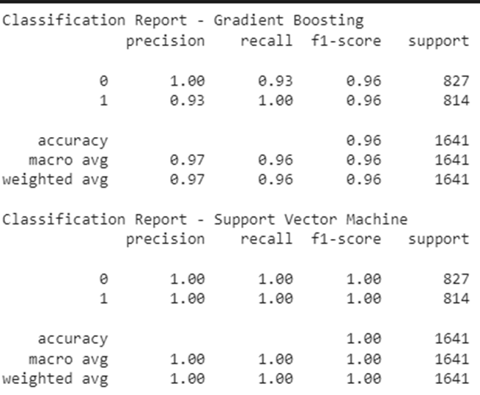

Model Accuracy
The Model Accuracies are :

Slide 16
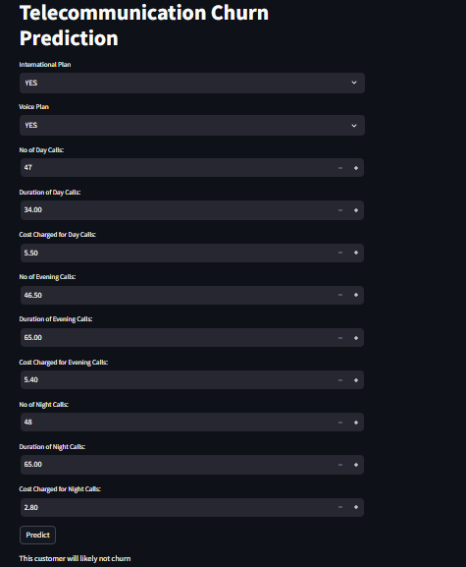
Deployment
We have used Titlebar, Select box , Number In put bars to enter the User input values and a Predict Button for predictions

Slide 17
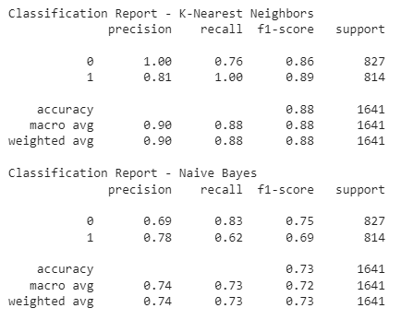
Problem faced during the project
We got different f-1 score , Precision values for each rows in dataset ,in order to overcome this problem we have used feature engineering techniques like Recursive feature selection and True positive ,True negative value matrix.

Slide 18
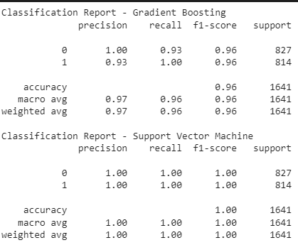
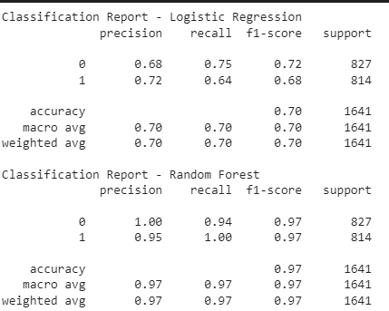

Slide 19
Thankyou
..

